Slide 1
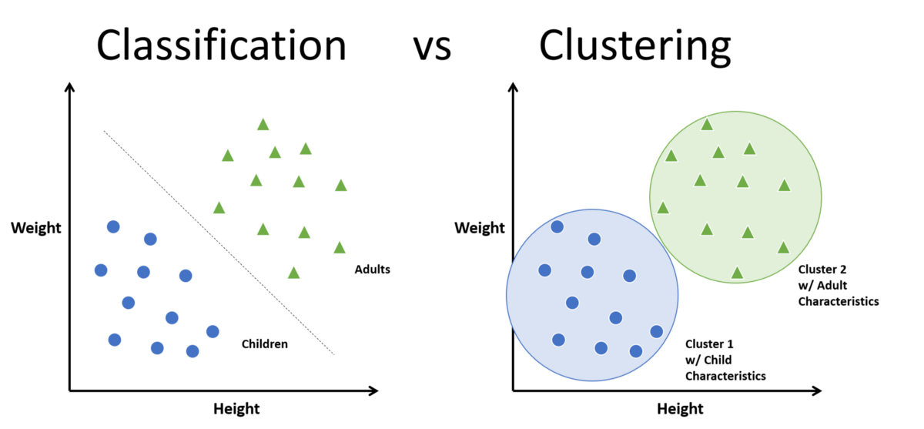
Classification & clustering methods
Both methods are used in data mining for analysing the data sets and divide them in different way

Slide 2
Classification & clustering methods
Classification
The techniques used here is a supervised learning to help find the relation between features and the assigned labels.
It use Some Algorithms such as:
Logistic Regression
Neural Networks
Support Vector Machines
Clustering
The techniques used here is unsupervised learning to help organise the data point into homogeneous group that have the similarities. Because the data is not pre-labelled, there is no training process. clusters are created using similarity functions that measure the distance between points.
It use Some Algorithms such as:
K-means
K-medoids
Density Based

Slide 3
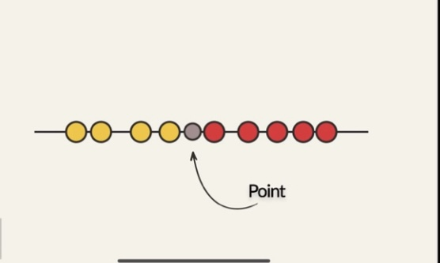
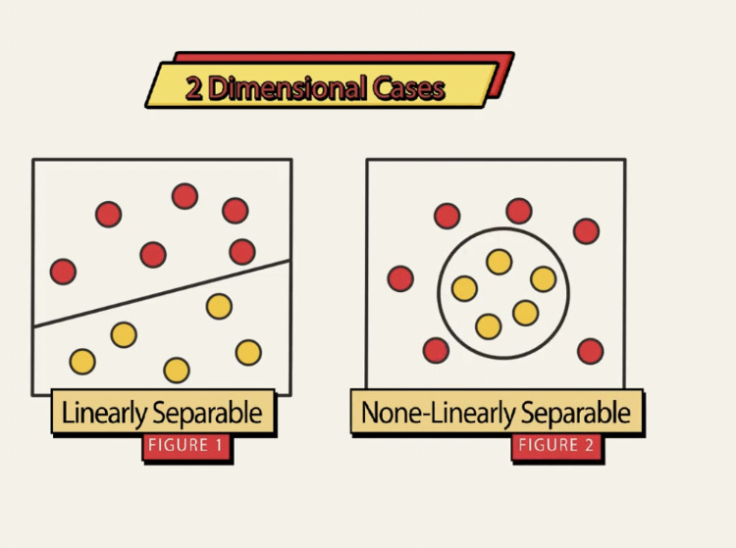
Support vector machines
It’s a supervised machine learning algorithm.
It is input labeled data and output optimal hyperplane

Slide 4
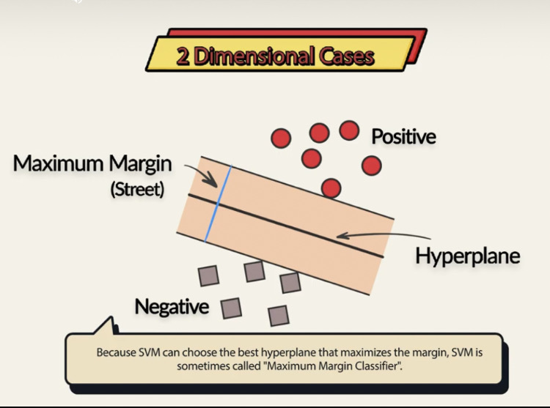
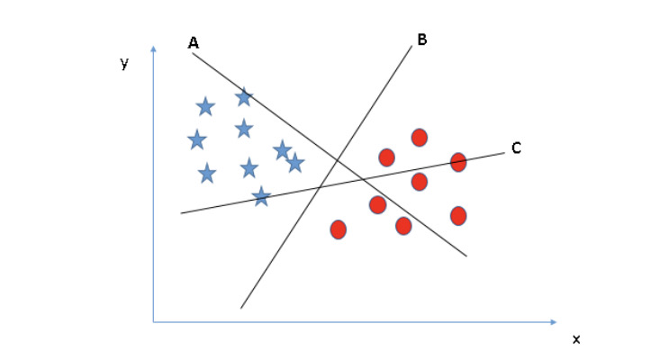
SVM also help to find optimal hyperplane that segregates the two classes better

Slide 5
References
https://kevin-c-lee26.medium.com/machine-learning-101-classification-vs-clustering-e11b12c71243
https://www.analyticsvidhya.com/blog/2017/09/understaing-support-vector-machine-example-code/

